Slide 1
Neural network-based audio effect emulation
Brijee Rana
Br1e21
Msc data science

Slide 2
Introduction
Replicate audio effects
End-to-end black box method
Recurrent Neural networks (LSTM/GRU)
Music producers and guitar players often use audio effects for artist/creative endeavours.
Analog devices are expensive, scare and fragile
Contemporary digital audio effect model do perform as well as these analog devices.

Slide 3
Aims and objectives
Modern methods currently use grey/white box modelling e.g. circuit simulation, complex mathematical algorithms
Investigate the performance of RNN’s with non-linear effect (fuzz) and time-varying effect(chorus).
Find suitable network architecture.
Explore parameters and network structure.
Implement and produce sounds with the audio effect from a given input.

Slide 4
Fuzz
Aggressive distortion sound.
Distorts audio waves non-linearly into square waves, adding complex overtones as the volume is increased and waves are clipped.
Chorus
Mimics a choir.
Modulation, time-varying audio effect.
Duplicates the audio wave, plays it alongside it at different pitches and speeds.

Slide 5
Recurrent neural networks
Similar to feedforward neural networks but has feedback connections. Useful for sequential data e.g discrete time series data like audio waves.
RNNs commonly have vanishing/exploding gradients when doing backpropagation through time.
LSTM used to solve this issue with its unique gated structure and ability to store memory in its cells, thus learning long-term dependencies.
Gated Recurrent Units are LSTMs without an output gate, so it fully writes the contents from its memory cell to the larger network at each time step.

Slide 6
Data and data pre-processing
The dataset IDMT-SMT-Audio-Effects dataset, contains 55044 audio files with 11 different audio effects.
Concatenated unprocessed audio files then used my own DAW and audio effect system to apply fuzz and chorus effect.
Normalised the amplitude of this long audio file so that the sensitive network does not get affected by differences in volume, and graph plotting is simpler.
Split ½ into training, ¼ each into testing and validation set.

Slide 7
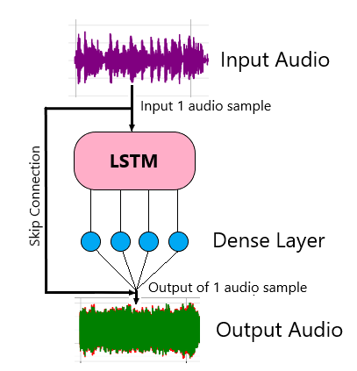
Neural network architecture
Found RNN network architecture from a paper by the Aalto University Acoustics Lab, Finland, which explored tube amplifier emulation.
Used their network to train my data, investigate RNN structures and performance as well as plot graphs.
Network contains LSTM layer followed by dense layer, skip connected used so that network can learn difference between input and target.

Slide 8
Demonstration

Slide 9
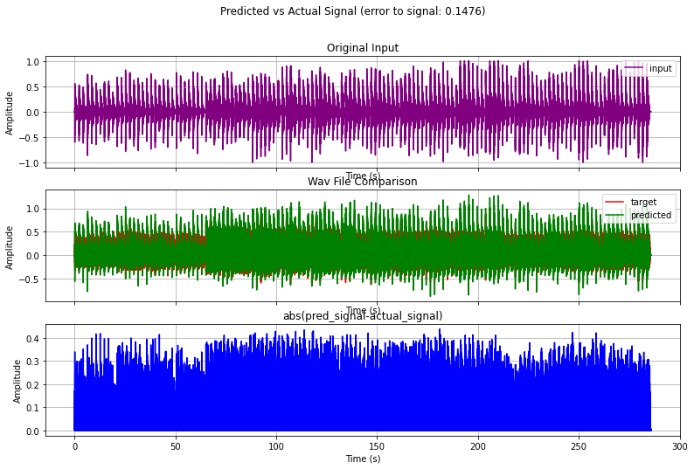
Results (FUZZ):
Relatively good performance, sonically convincing.
Test loss = 0.113
Validation loss = 0.147
{"hidden_size": 32, "unit_type": "LSTM", "loss_fcns": {"ESR": 0.75, "DC": 0.25}, "pre_filt": "None“}
Early stopping at 130 epochs,
23 minutes to train.

Slide 10
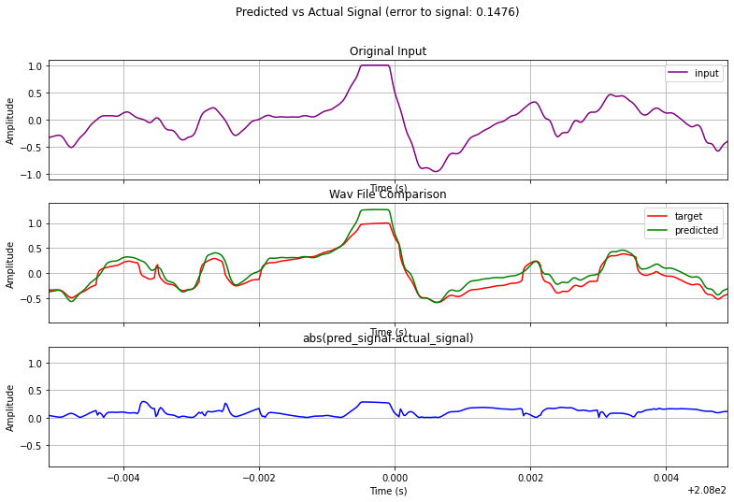

Slide 11
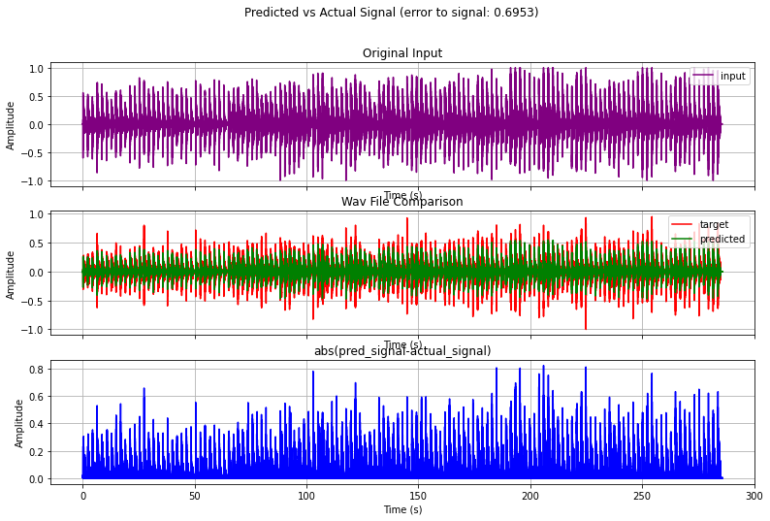
Results (CHORUS):
Very poor performance, difficult to hear the audio effect applied.
Test loss = 0.291
Validation loss = 0.695
{"hidden_size": 64, "unit_type": "GRU", "loss_fcns": {"ESR": 0.75, "DC": 0.25}, "pre_filt": "None“}
Early stopping at 74 epochs.
13 minutes to train.

Slide 12
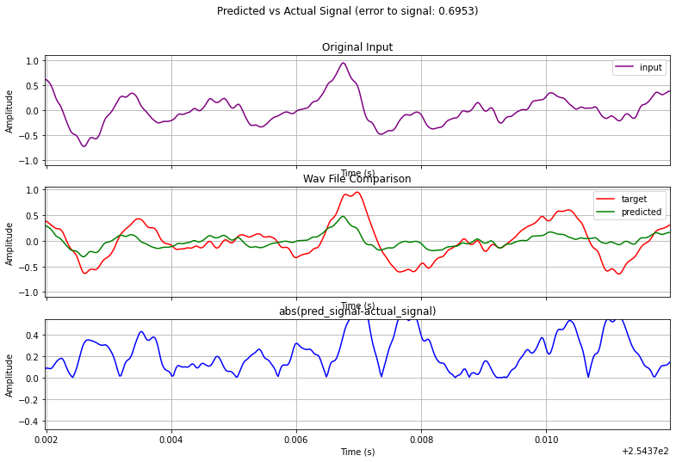

Slide 13
Discussion
GRU take shorter time than LSTM but perform slightly worser.
Network can model fuzz and by extension most non-linear audio effects.
Was very unsuccessful at replicating chorus. Model could not replicator any other type of time-varying audio effect.
Increasing the hidden size layer slightly increases performance but takes longer for the network to be trained – computational cost.

Slide 14
Conclusion
RNN can definitely be used to model non-linear audio effects to a believable degree but not complex time-varying audio effects, further experiments and approaches would have to be explored.
I can see this method of modelling audio effects be further developed and used in the future.
In the future:
Make the model work in real time.
Investigate different models, i.e autoencoders.
Add parameters i.e volume, equalizations.

